Slide 1

Heart Failure Data Analysis
WHAT CAUSES HEART DISEASE?
ANDREW SIQUEIRA

Slide 2
Attribute Information
Age: age of the patient [years]
Sex: sex of the patient [M: Male, F: Female]
Chest Pain Type: chest pain type [TA: Typical Angina, ATA: Atypical Angina, NAP: Non-Anginal Pain, ASY: Asymptomatic]
Resting BP: resting blood pressure [mm Hg]
Cholesterol: serum cholesterol [mm/dl]
Fasting BS: fasting blood sugar [Fasting BS > 120 mg/dl or Fasting BS ≤ 120 mg/dl]

Slide 3
Attribute Information (continued…)
Resting ECG: resting electrocardiogram results [Normal: Normal, ST: having ST-T wave abnormality, LVH: showing probable or definite left ventricular hypertrophy]
Max HR: maximum heart rate achieved [Numeric value between 60 and 202 BPM]
Exercise Angina: exercise-induced angina [Y: Yes, N: No]
Old peak: old peak = ST [Numeric value measured in depression]
ST Slope: the slope of the peak exercise ST segment [Up: upsloping, Flat: flat, Down: down sloping]
Heart Disease: output class [1: heart disease (HD), 0: Normal (Norm)]

Slide 4
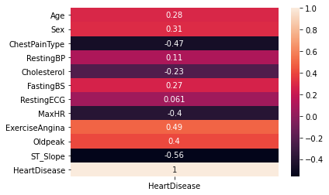
Correlation Matrix of Heart Disease with All Factors
The top factors that appears to have a strong relationship with Heart Disease are:
ST Slope
Chest Pain Type
Exercise Angina
Maximum Heart Rate
Old Peak

Slide 5
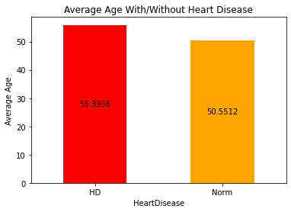
Average Age With/Without Heart Disease
Average Age appears to be slightly higher in patients with Heart Disease condition
The difference in Average Age appears to be very minimal

Slide 6
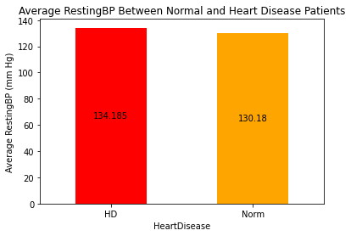
Average Resting Blood Pressure With/Without Heart Disease
Average Resting BP appears to be slightly higher in patients with Heart Disease condition
The difference in Average Resting BP appears to be very minimal

Slide 7
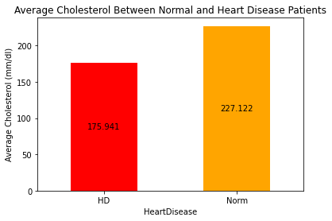
Average Cholesterol With/Without Heart Disease
Average Cholesterol appears to be much lower in patients with Heart Disease condition
The difference in Cholesterol appears to be extremely significant

Slide 8
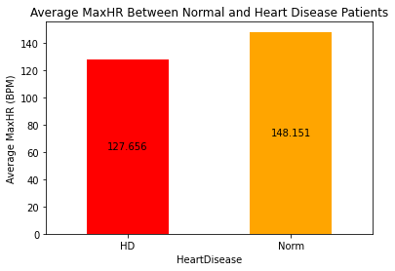
Average Maximum Heart Rate With/Without Heart Disease
Average Maximum Heart Rate appears to be much lower in patients with Heart Disease condition
The differences in Maximum HR appears to be very significant

Slide 9
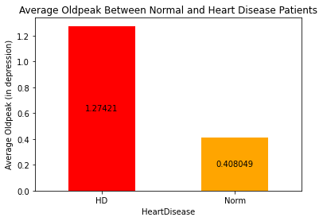
Average Old Peak With/Without Heart Disease
Average Old Peak appears to be extremely higher in patients with Heart Disease condition
The difference in Old Peak appears to be extremely significant

Slide 10
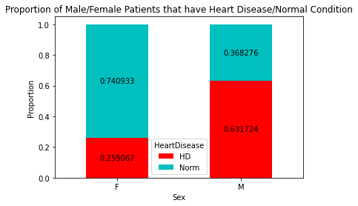
Proportion of Heart Disease and Normal Patients Between Sexes
The differences in proportions appears to be extremely significant
Males have the higher proportion of Heart Disease condition than Females

Slide 11
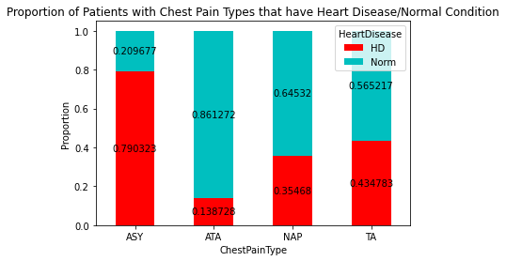
Proportion of Heart Disease and Normal Patients with Chest Pain Type
The differences in proportions appears to be extremely significant
Asymptotic pain has the highest proportion of Heart Disease condition
Atypical angina pain has the lowest proportion of Heart Disease condition

Slide 12
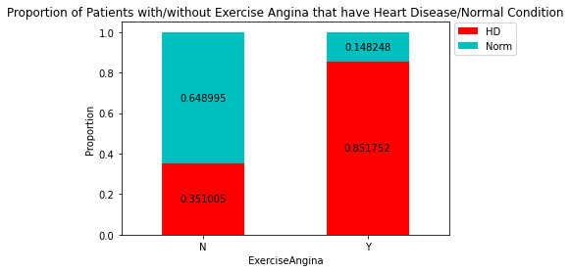
Proportion of Heart Disease and Normal Patients with/without Exercise Angina
The difference in proportions appears to be extremely significant
Having exercise angina has the highest proportion of Heart Disease condition

Slide 13
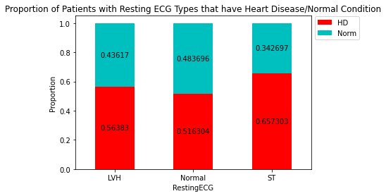
Proportion of Heart Disease and Normal Patients with Resting ECG Types
The differences in proportions appears to be moderately significant
ST-T wave abnormality has the highest proportion of Heart Disease condition
Normal result has the lowest proportion of Heart Disease condition

Slide 14
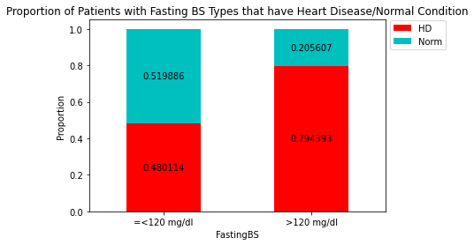
Proportion of Heart Disease and Normal Patients with Fasting Blood Sugar Levels
The difference in proportions appears to be extremely significant
Fasting Blood Sugar > 120 mg/dl has the highest proportion of Heart Disease condition

Slide 15
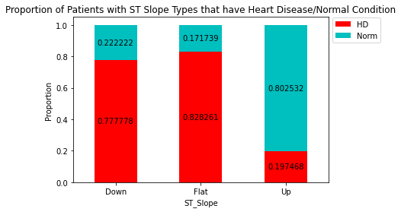
Proportion of Heart Disease and Normal Patients with ST Slope Types
The differences in proportions appears to be extremely significant
Flat slope type has the highest proportion of Heart Disease condition
Up slope type has the lowest proportion of Heart Disease condition

Slide 16
Conclusion
Heart Disease appears to be more common in patients:
that are males
with lower cholesterol
with lower Maximum Heart Rate
with higher Old Peak
with Asymptotic chest pain
with Exercise Angina
with Fasting Blood Sugar > 120 mg/dl
with Flat and Downward slopes during peak exercise

Slide 17
Recommendations
To Reduce Chance of Getting Heart Disease/Failure:
Increase cholesterol levels by modifying diet plan and through exercise
Increase Maximum Heart Rate during exercise or activities
Reduce Old Peak (in depression)
Reduce Fasting Blood Sugar levels immensely through eating healthy
Increase intensity and resistance through upward slopes during peak exercise
Reduce stress

Slide 18



THANK YOU!

